Slide 1
MODELING THE EFFECTS OF DRUGS OF ABUSE ON HIV INFECTIONS WITH TWO VIRAL SPECIES
Peter Uhl and Naveen K. Vaidya
San Diego state university
Computational science research center

Slide 2
HIV epidemiology
HIV is a viral infection that over time causes acquired immune deficiency syndrome (AIDS)
~37 million carriers world wide, with 940,000 deaths in 2017 (WHO)
Transmitted mostly through sexual transmission and needle sharing

Slide 3


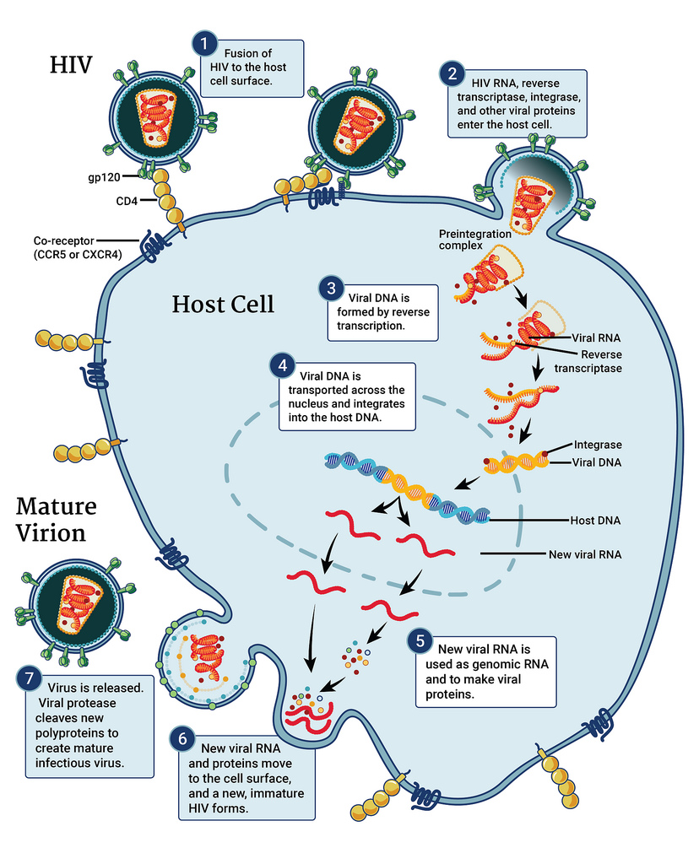
https://www.niaid.nih.gov/diseases-conditions/hiv-replication-cycle

Slide 4
Background-CELLULAR IMMUNE RESPONSE
Infected cells signal a cellular immune response by the host’s immune system
Cytotoxic T-lymphocytes (CTLS) recognize epitopes on infected cells and destroy them
Killing by CTLs puts pressure on the virus to mutate to a from that is not detected by the immune response

Slide 5
Background-viral evolution
Cytotoxic T-lymphocytes (CTLs) recognize epitopes on infected cells and destroy them
Killing by CTLs puts pressure on the virus to mutate to a from that is not detected by the immune response
Mutant viruses are distinguished from founder virus by i) fitness cost of mutation, ii) ratio of escape from immune response

Slide 6
Background-drug conditioning
Drugs of abuse, such as morphine, have been shown to cause adverse effects with regard to HIV infections including:
Increased viral load
Weakened immune response
Increased pathogenesis
Decreased viral evolution
Research Question:
Can the altered viral evolution and weakened immune response caused by morphine use explain the increased viral load?

Slide 7
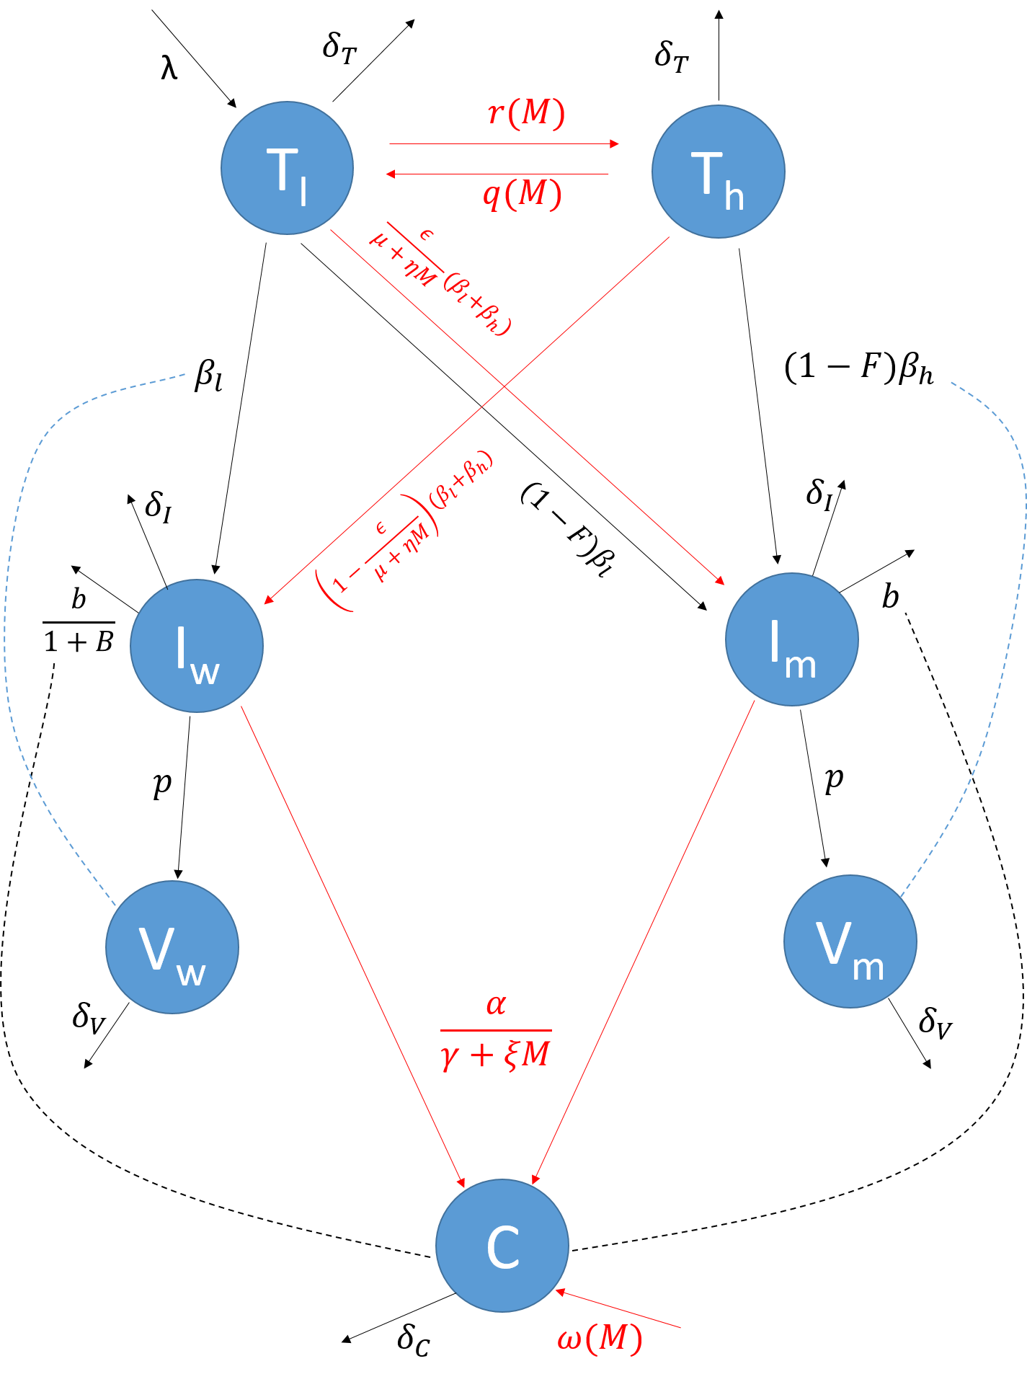
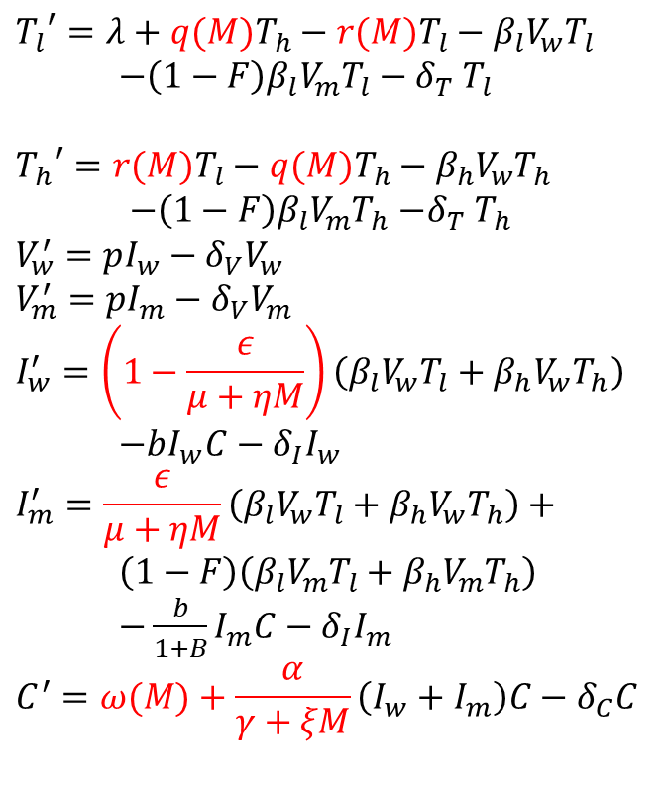
Mathematical model
$${T_{l}}^{′}=λ+q(M)T_{h}−r(M)T_{l}−β_{l}V_{w}T_{l}$$
$−{\left(1−F\right)β}_{l}V_{m}T_{l}−δ_{T} T_{l}$
$${T_{h}}^{′}=r(M)T_{l}−q(M)T_{h}−β_{h}V_{w}T_{h}$$
$−{\left(1−F\right)β}_{l}V_{m}T_{h}$ $−δ_{T} T_{h}$
$$V_{w}^{′}=pI_{w}−δ_{V}V_{w}$$
$$V_{m}^{′}=pI_{m}−δ_{V}V_{m}$$
$$I_{w}^{′}=\left(1−\frac{ε}{μ+ηM}\right)\left(β_{l}V_{w}T_{l}+β_{h}V_{w}T_{h}\right)$$
$−bI_{w}C−δ_{I}I_{w}$
$$I_{m}^{′}=\frac{ε}{μ+ηM}\left(β_{l}V_{w}T_{l}+β_{h}V_{w}T_{h}\right)+$$
$\left(1−F\right)\left(β_{l}V_{m}T_{l}+β_{h}V_{m}T_{h}\right)$
$−\frac{b}{1+B}I_{m}C−δ_{I}I_{m}$
$$C^{′}=ω(M)+\frac{α}{γ+ξM}\left(I_{w}+I_{m}\right)C−δ_{C}C$$

Slide 8
Results-simulations
Adding morphine to the dynamics causes an increase in viral load and pathogenesis
Morphine case causes a two-log increase in set-point viral load

Slide 9
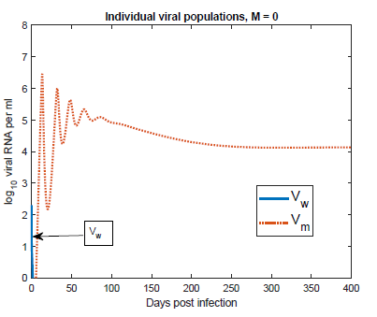
Results-simulations
With no morphine, the mutant virus dominates and the wild-type virus goes extinct

Slide 10
Results-simulations
With higher morphine, the wild-type virus dominates but a small amount of mutant persists due to mutation

Slide 11
Results-basic reproduction number
Basic reproduction number: average number of infections resulting form one initial infection
Calculated for two viral populations using next-generation operator method
Calculated as function of M

Slide 12
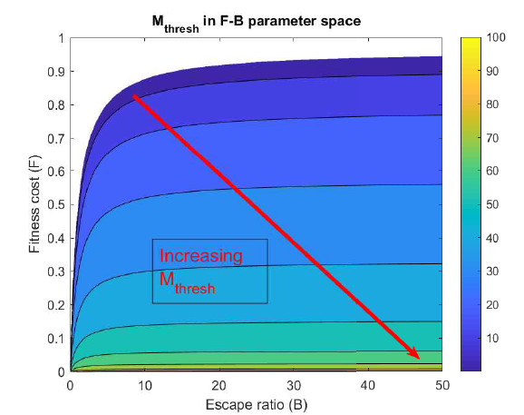
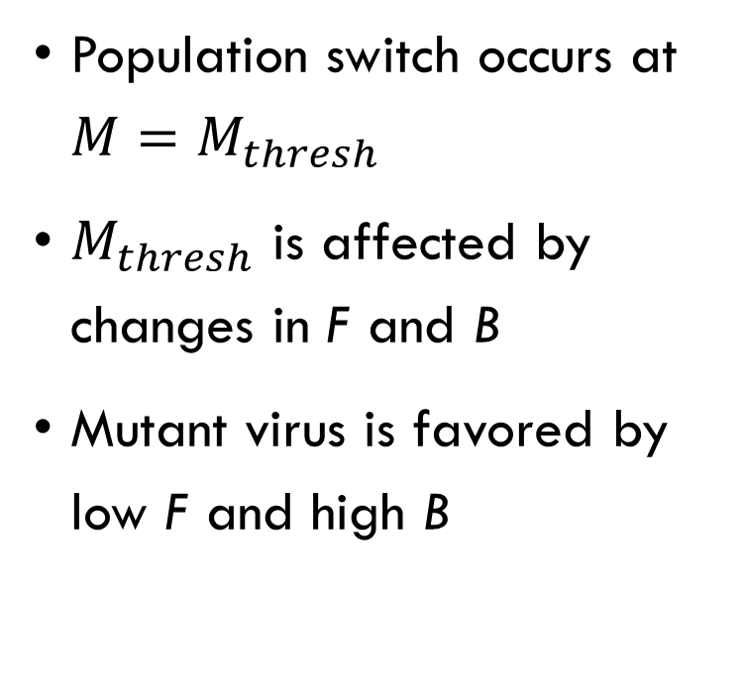
Results-basic reproduction number
Population switch occurs at $M=M_{thresh}$
$M_{thresh}$ is affected by changes in F and B
Mutant virus is favored by low F and high B

Slide 13
Results- local stability analysis of equilibria
Three biologically relevant equilibria: infection free (IFE), mutant only (MOE), and coexistence
Stability of IFE is determined by basic reproduction number
Stability of MOE and coexistence equilibrium is determined by linearizing the model and calculating eigenvalues, in coordination with basic reproduction number

Slide 14
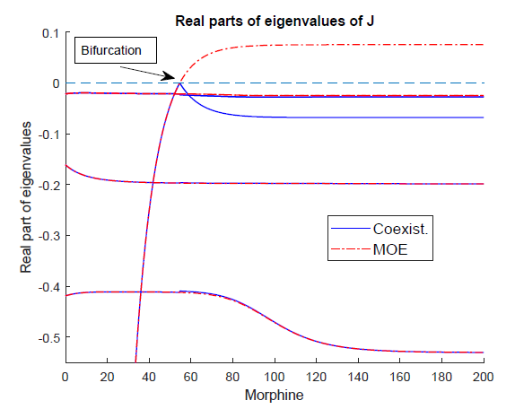
Results-local stability analysis of equilibria
MOE is stable for low morphine
Increasing morphine causes the MOE to become unstable and appearance of the stable coexistence equilibrium

Slide 15
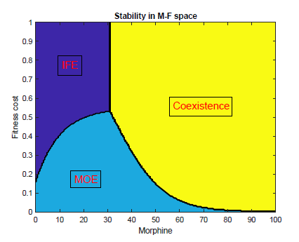
Results-local stability analysis of equilibria
High fitness cost and low morphine gives the IFE
Low fitness cost and low morphine gives the MOE
High morphine gives the coexistence equilibrium

Slide 16
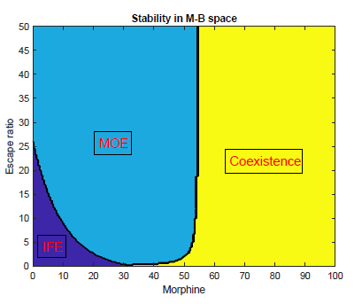
Results-local stability analysis of equilibria
High escape ratio and low morphine gives MOE
Low escape ratio and low morphine gives the IFE
High morphine gives the coexistence equilibrium

Slide 17
Results-local stability analysis of equilibria

Slide 18
Conclusions:
By decreasing the cellular immune response and viral evolution, morphine allows the wild-type virus to out compete the mutant and establish infection
With the weakened immune response, the wild-type virus achieves a higher set-point viral load when morphine is present
The long-term make up of the infection is determined by the morphine concentration and fitness of the mutant population

Slide 19
Acknowledgements:
This work was supported by a STEM scholarship award funded by the national science foundation GRANT DUE- 1259951
NSF grant DMS-1616299
NSF grant DMS-1836647

